Slide 1
The Relationship between Smartphone Usage & Sleep Quality
Hetvi Patel
Hafsa Chaudhry
Sai Teja Avadhoota
Sushanthik Reddy Poreddy
Swapan Gupta Chollati
Ujwala Namineni
Notes:
Everyone introduces themselves

Slide 2
Project Overview
The Problem and Introduction
Data Set and Analytical Tools
Analytic Model and Methods
Analysis Process and Findings
Recommendations & Limitations
Conclusion
Notes:
Hetvi

Slide 3
Introduction and the Problem:
Problem:
Dependency and addiction to smartphones has increased.
Increased usage shortens sleep time and decreases quality of sleep.
Blue Ray of screen impacts ability to fall asleep.
Research Question:
Does usage of smartphones at night cause poor sleep quality in university students/young adults?
Hypothesis:
Usage of smartphones at night does cause poor sleep quality in university students.
Notes:
Hafsa:
Since the development of the smartphone, usage has increased rapidly, which has brought about addiction and dependency towards the device.
Increased usuge near sleep time disturbs sleep. But why?
Well, Exposure to all colors of light helps control your natural sleep-and-wake cycle or circadian rhythm. More so than any other color, blue light messes with your body's ability to prepare for sleep because it blocks a hormone called melatonin that makes you sleepy. Blue light is the light that emanates from our screens, hence why if you are only focusing on your screen OR you're in bed with the only light being on is your phone screen, then you should notice that you can't fall asleep as quickly.
So the question remains:
But what about the most dependent and addicted group: young adults.
We will be exploring the whys and hows in our project

Slide 4
Dataset
Tools and Methods
Gajjar, K. (2021, March 26). Sleep pattern. Kaggle. Retrieved November 18, 2021, from https://www.kaggle.com/krupa1999/sleep-pattern.
Country: India
Gender: Females, Males, Prefer Not to Say
Age: 20-59
Method: Questionnaire survey
Physical exercise
Hours of sleep at night
Time spent on smartphone
Food and drink intake
Physical or mental illness
Sleep direction
Smoking habits
Blue light filter usage
Python
Descriptive statistical analysis
Blue light filter usage amongst males and females
Blue light filter usage across ages
Linear regression
P-values to test hypothesis
Significance Levels & Confidence Intervals
Correlation using coefficients between:
Screen time and sleep time for females and males
Age and sleep time for females and males
Residual and R-Squared Values
Notes:
Hetvi
Data Set - SLIDE 4
got it from Kaggle
originated in India and published in March 2021
aged 20-59 (any age after 28 will be considered an outlier, but since we cannot change the data, we are keeping it in our studies)
questionnaire
Physical exercise - helps reduce stress and tires out body
Hours of sleep at night - average hours of sleep
Time spent on smartphone - smartphone usage
Food and drink intake - # of meals could affect sleep quality as well as alcohol intake
Physical or mental illness - mental illnesses such as anxiety or depression can cause sleep quality to decrease
Sleep direction - sleeping in South direction could improve sleep quality because the human head has a polar-like attraction and needs to face South to attract opposite poles while sleeping
Smoking habits - smoking habits could cause sleep apnea
Blue light filter usage - the screen exposes our eyes to all colors that affect our body’s circadian rhythm. The color blue affects our body’s ability to induce sleep more so than the other colors because it blocks the production of melatonin, which helps the body induce sleep.
Methods - SLIDE 5
linear regression -
using p-values to test hypothesis
if p-value less than alpha/significance level of 0.05 = fail to reject null hypothesis and reject alternative hypothesis (our hypothesis)
correlation coefficients -
negative coefficient indicates low correlation between independent and dependent variable
residual and R-squared analysis
residuals are used to find the difference between observed and predicted values. a score of 0 indicates the model is not biased and is perfect
negative = over predicted, actual values less than predicted values
over 0 = under predicted values and is biased
descriptive statistics
provide summaries such as median, mean, standard deviation, 25th, 50th, and 75th percentiles
std deviation = higher indicates values lie further from mean and is present in normal distribution

Slide 5
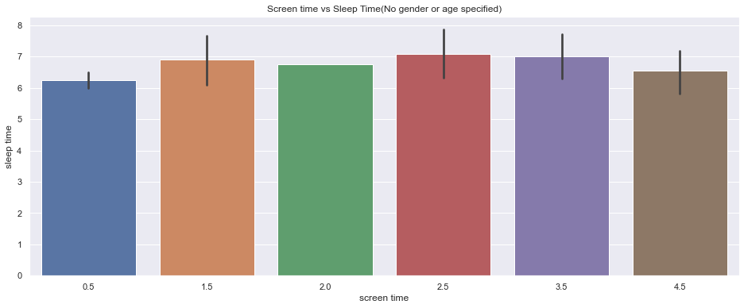
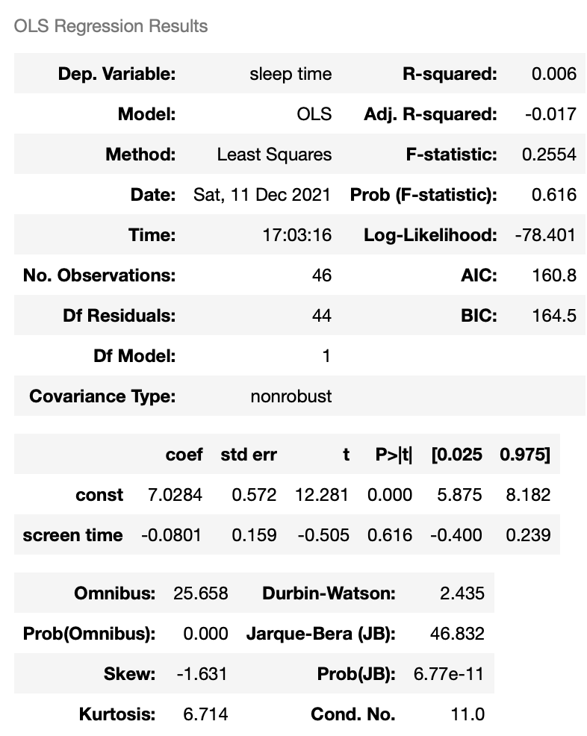
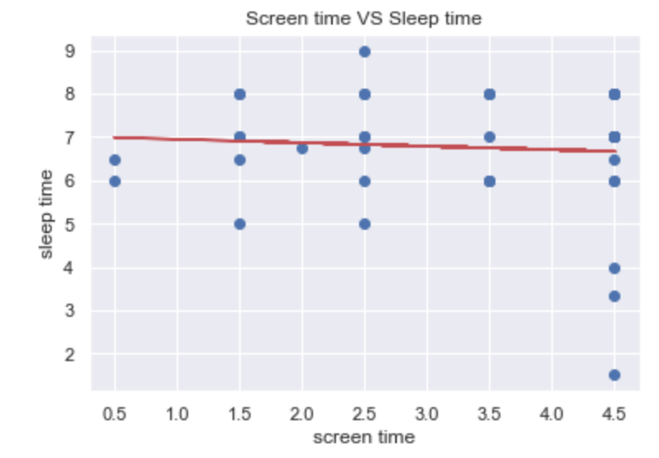
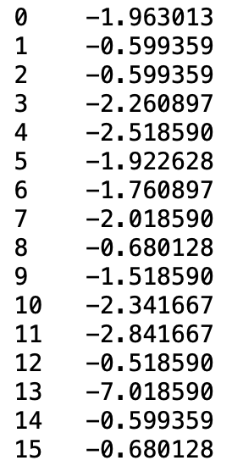
Overall Screen Time vs Sleep Time (Across all Genders and Ages)
Residuals:
Notes:
Hetvi
p-value of screen time is: 0.616
more than alpha of 0.05 = indicating that screen time has no effect on sleep duration across all genders and ages
coefficient is negative: -0.0801
indicating that there is no correlation between screen time usage and sleep duration across all genders and ages
Residual analysis
printing first 15
below zero - too high of a predicted value - observed data points are actually less than predicted data points
sleep time and screen time data
R-squared
shows correlation
0.006 = low correlation between screen time usage and sleep duration

Slide 6
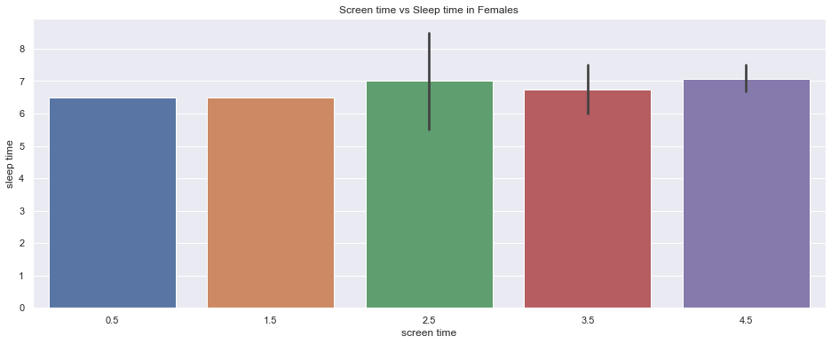
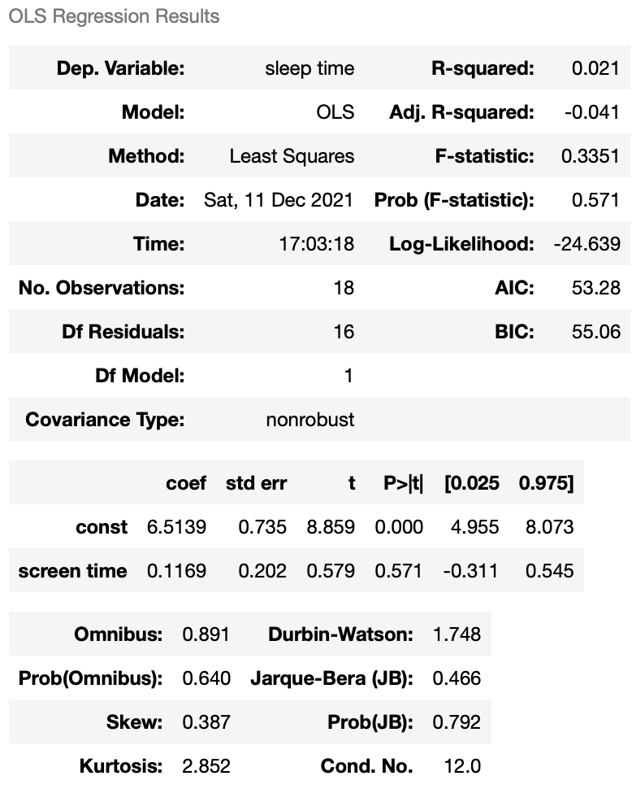
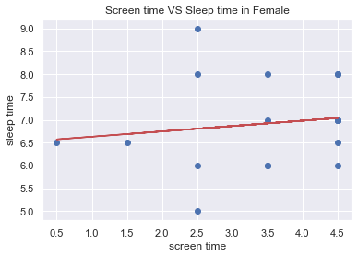
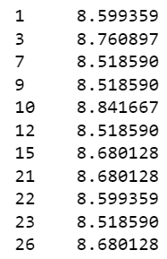
Screen Time vs Sleep Time in Females
Residuals:
Notes:
Bar chart
Regression results + linear regression graph
Residual analysis
The model is biased and it is overpredicted. R squared value <0.1 shows low correlation. If >0.9 then have strong correlation.
Coefficient >0 so there could be a potentially low correlation between screen time and sleep time.
p>alpha the hypothesis is rejected.

Slide 7
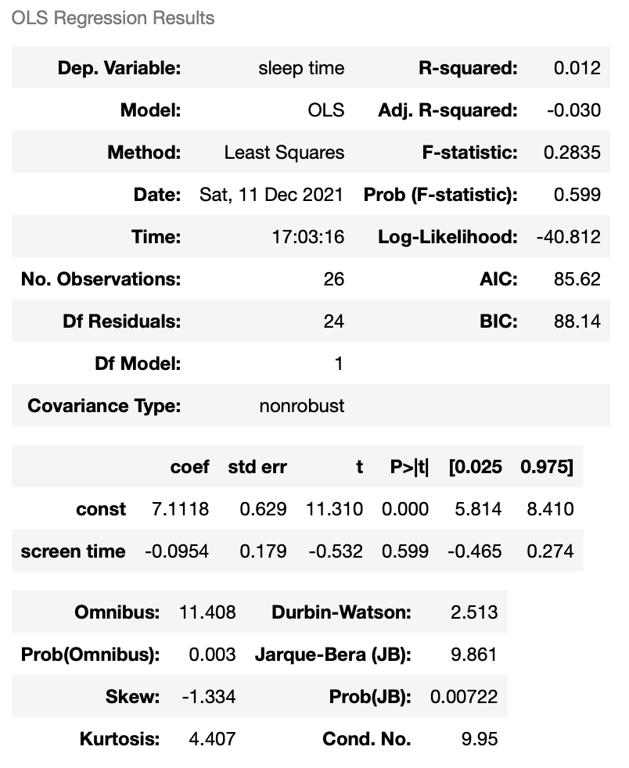
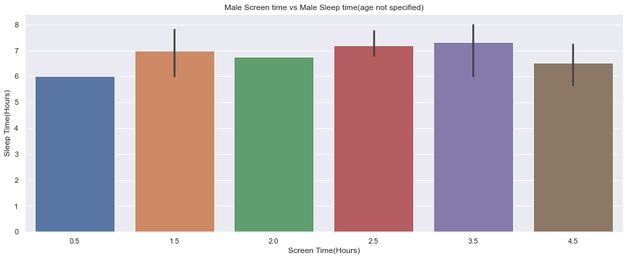
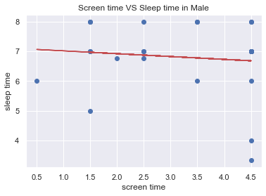
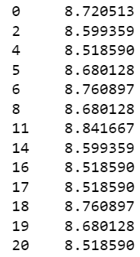
Screen Time vs Sleep Time in Males
Residuals:
Notes:
Bar chart
Regression results + linear regression graph
Residual analysis

Slide 8
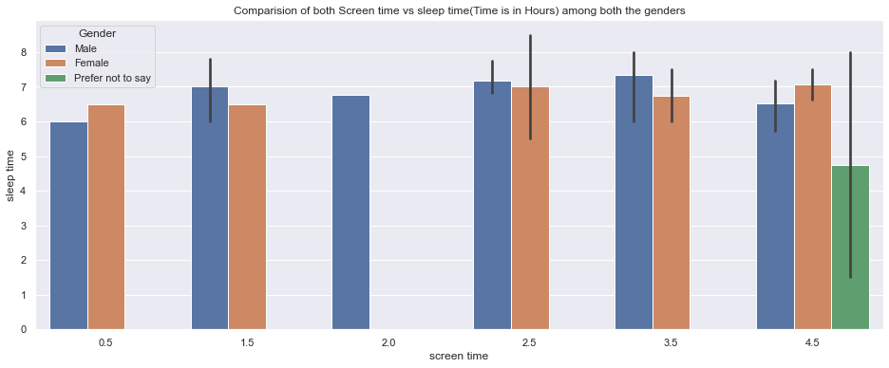
Screen time Vs Sleep time across all Genders

Slide 9
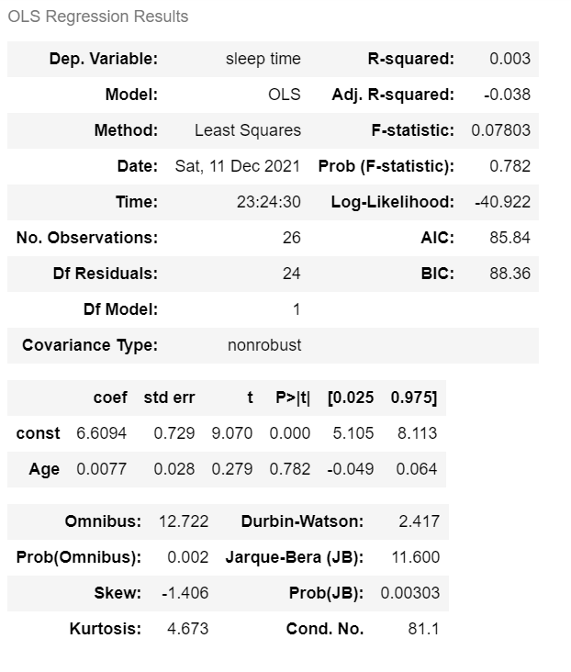
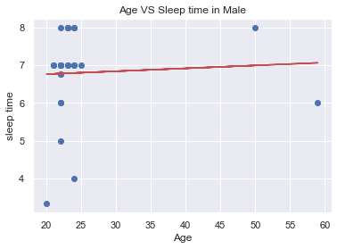
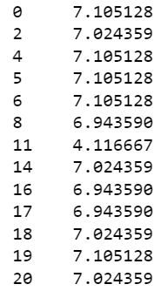
Age vs Sleep Time in Males
Residuals:
Notes:
Bar chart
Regression results + linear regression graph
Residual analysis

Slide 10
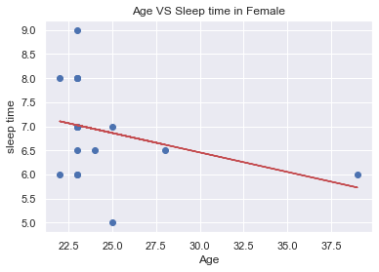
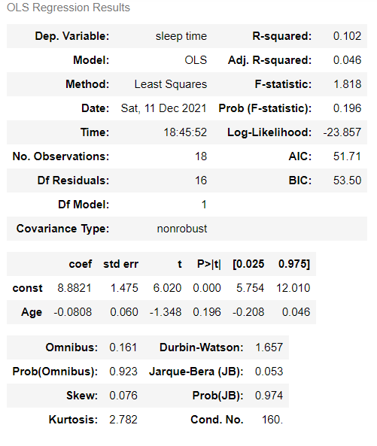
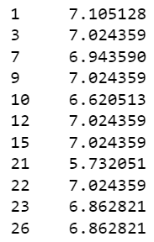
Age vs Sleep Time in Females
Residuals:
Notes:
Bar chart
Regression results + linear regression graph
Residual analysis
Python:
Linear Regression:
It is predictive analysis technique which uses the historical data and predict the outcome variable.
Here we are running regression analysis to predict the outcome variable sleep time.
The equation to predict the outcome variable is Yₑ = α + β X
The objective of the least squares method is to find values of α and β that minimise the sum of the squared difference between Y and Yₑ.

Slide 11
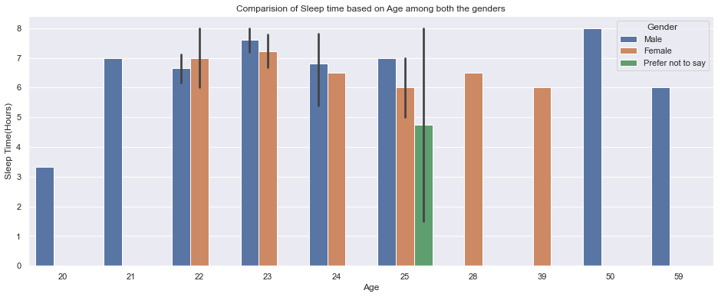
Visual Representation of Age vs Sleep Time Across all Genders

Slide 12
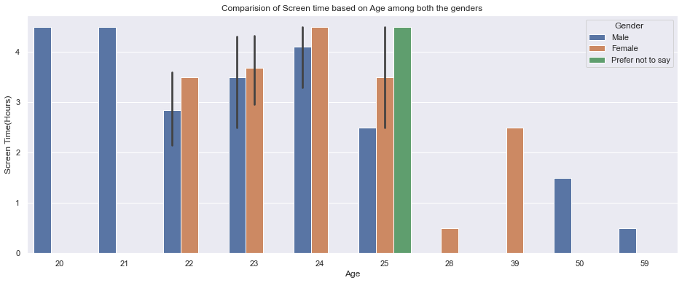
Visual Representation of Age vs Screen Time Across all Genders

Slide 13
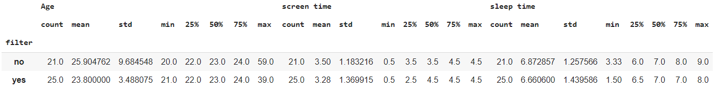
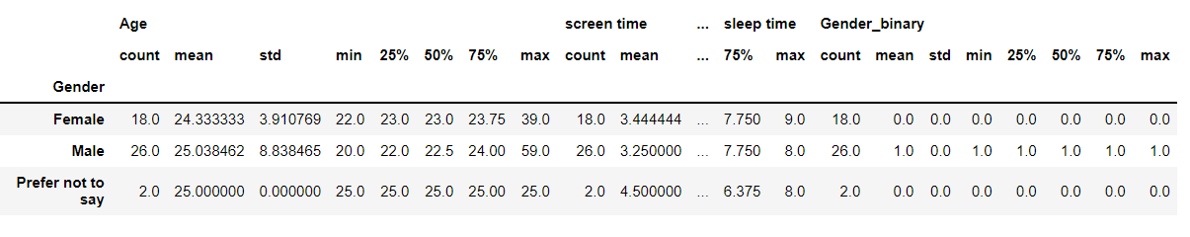
Does using blue light filter affect sleep quality?
Notes:
Statistical analysis of bluelight filter, age, gender on sleep time
The statistical analysis done between bluelight filter and age explains how the sleep time is being affected based on the screen time value in case of with and without filters.

Slide 14
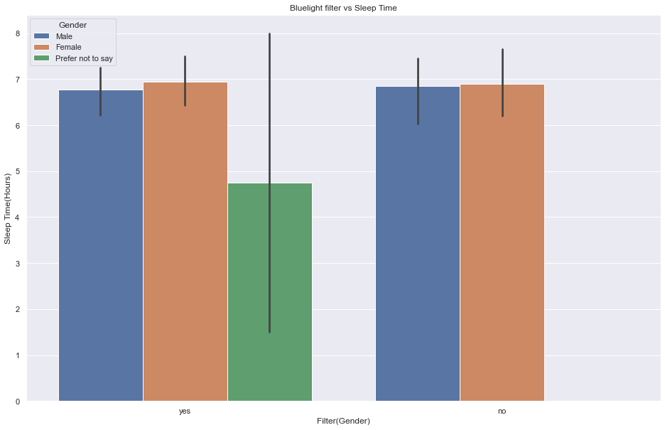
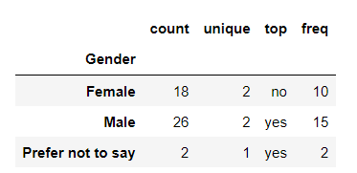
Statistical Analysis between Blue Light Filter and Sleep Time with Respect to Gender

Slide 15
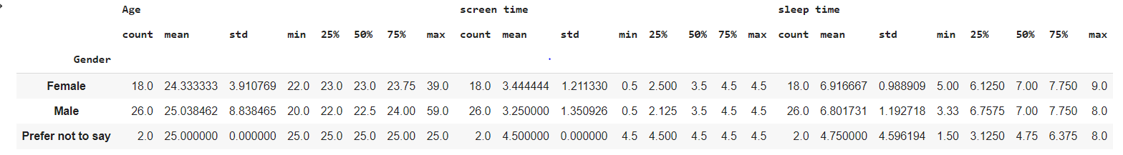
Statistical Analysis between Screen Time and Sleep Time with Respect to Age Across all Genders
Observation:
A statistical analysis is done between the fields screen time and sleep time with respect to Age
Mean of females and males of sleep time and screen time do not support our hypothesis

Slide 16
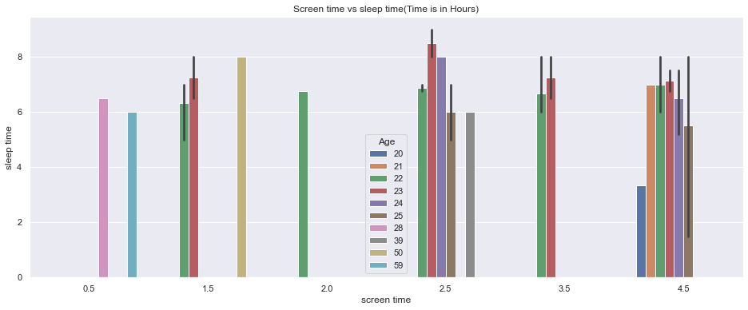
Visualization of Screen Time and Sleep Duration with Respect to Age Across all Genders

Slide 17
Interpretation of Results
Linear Regression support our hypothesis however,
Our Statistical Analysis results revealed that smartphone dependencies were not significant predictors of sleep quality.
Scores indicate that sleep time was relatively the same across all genders regardless of screen time.
Correlation does not imply causation!!
Other factors?
Notes:
Hafsa- Linear Regression for age over sleep time reveals that males experience more sleep than females with age. In addition, females experience more screen time than males with age. This discovery would support our hypothesis however,
Our Statistical Analysis results and p-value revealed that smartphone dependencies were not significant predictors of sleep quality. Our statistical value was high, representing that a large difference exists between the two variables. And that our hypothesis will be rejected.
Scores indicate that sleep time was relatively the same across all genders regardless of screen time.
Therefore, correlation does not imply causation. just because a relationship exists between two variables, does not mean one variable causes the other
Other factors that could result in why females are getting less sleep with age but more screen time while males are getting more sleep with age and less screen time could be gender and societal duties performed. It could also be from health related issues: Starting from a women’s first menstrual cycle, they tend to suffer insomnia. Irregular cycles and menstrual pain negatively impacts sleep. change in hormones through uses of contraceptives are known to cause insomnia and daytime sleepiness. Premenopause also disturbs sleep ability. Menopause with age also creates hot flashes and sweat which will keep you from falling asleep. The well known hormonal changes causes insomnia and in addition those changes can cause depression which is also linked to insomnia.

Slide 18
Recommendations
Limitations
Improve Health Related Activities
Nutritional Behavior
Stress Management Behavior
Bedtime Routine
Physical Activity
Data:
Relatively small study population.
Unequal gender data.
No clear indication of where the data study was done.
Biased questionnaire
Model:
As the dataset is limited, residuals are scattered.
Residual scores indicate models are overpredicted and underpredicted
Larger datasets would give accurate results.
Notes:
Hafsa- recommendations
improving health-related behaviors, such as nutritional behavior, stress management, physical activity, and development of a bedtime routine, have shown an enhancement towards sleep quality (Wang, 2019). By contrast, young adults with poor health-related behaviors, such as a tendency to eat unhealthy and high caloric diet, smoking and alcohol abuse, self-harm, have shown a correlation towards poor sleep quality (Wang, 2019).
Ujwala- Limitations:
Data:
Several limitations of the present study should be considered. The relatively small study population was one such issue. Moreover, all of the participants were university students, and may not represent the total population. All subjects were well-educated adults. Longitudinal studies and samples with different educational and age backgrounds are needed. The cross-sectional design, which is not the best way to evaluate causal relations, also limited the results. Furthermore, all of the scales were self-rated. Finally, the literature in this field is not yet rich enough.
They could have same sleep habits.
Model:
If the data increases, the variable which has no importance might have a significant effect on the required factor.
This leads to the change in the number of variables and eventually, the model might change.

Slide 19
Conclusion
The End
Notes:
Hafsa:
As the data shows: Sleep quality was significantly associated with degree of smartphone dependence, Studies have shown that young adults are at increased risk of having interrupted sleep due to smartphone usages as they are the most effected.
This negatively affects a young adult, specifically a university student, as sleep quality impacts depression and anxiety.
using the Pittsburgh Sleep Quality Index, Beck Depression Inventory, Beck Anxiety Inventory:
Smartphone Addiction Scale scores of females were significantly higher than those of males. Depression, anxiety, and daytime dysfunction scores were higher in the high smartphone use group than in the low smartphone use group. Positive correlations were found between the Smartphone Addiction Scale scores and depression levels, anxiety levels, and sleep quality scores.
Consequently, a relationship exists between smartphone usage, poor sleep quality and depressive symptoms in university students.
University students with high depression and anxiety scores should be carefully monitored for smartphone addiction.

